Slide 1


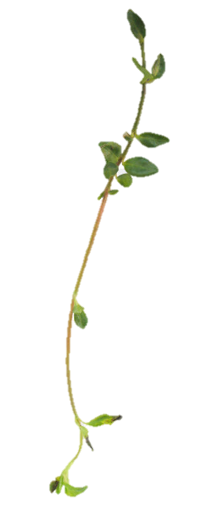


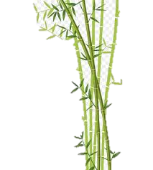

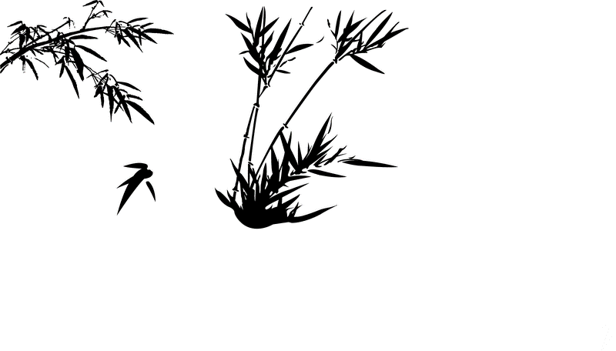

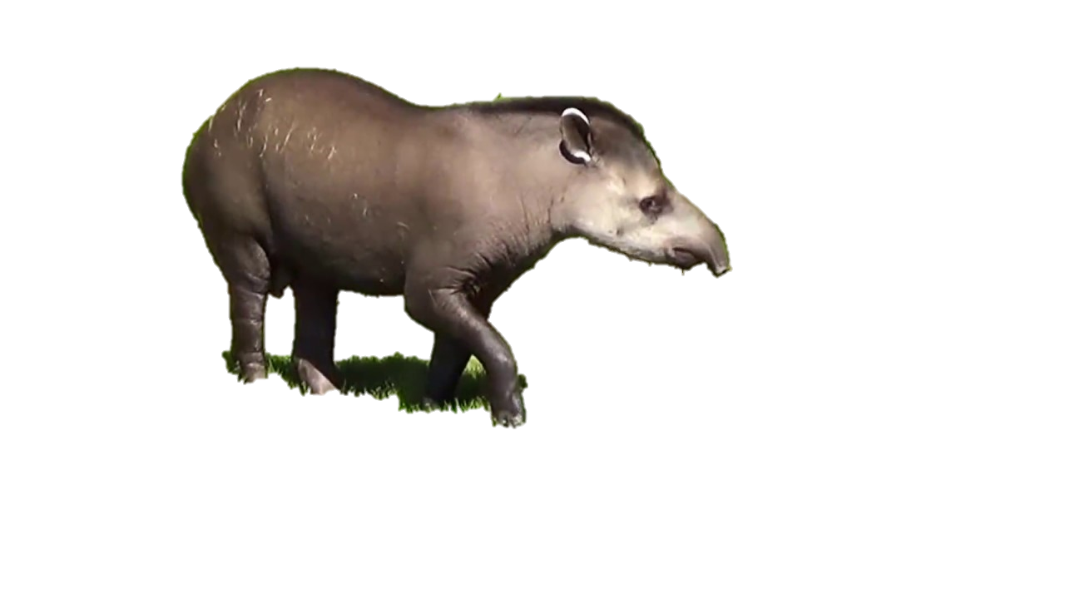

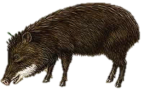
Do medium and large herbivores affect plant community dynamics in a tropical rainforest?
Yuri Souza
Exam 3: PCB-5443/2024

Slide 2

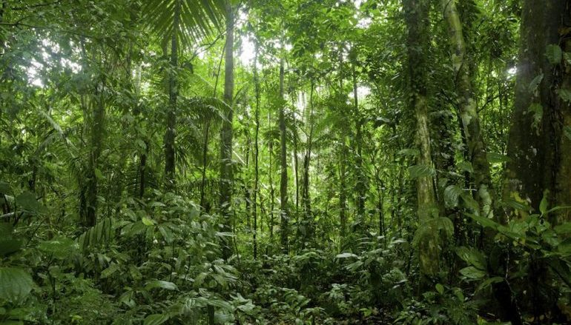







Medium and large terrestrial mammals shape tropical forests through herbivory and frugivory
Antagonistic vs Mutualistic
Horizontally stratified
Vertically stratified
2
1

Slide 3
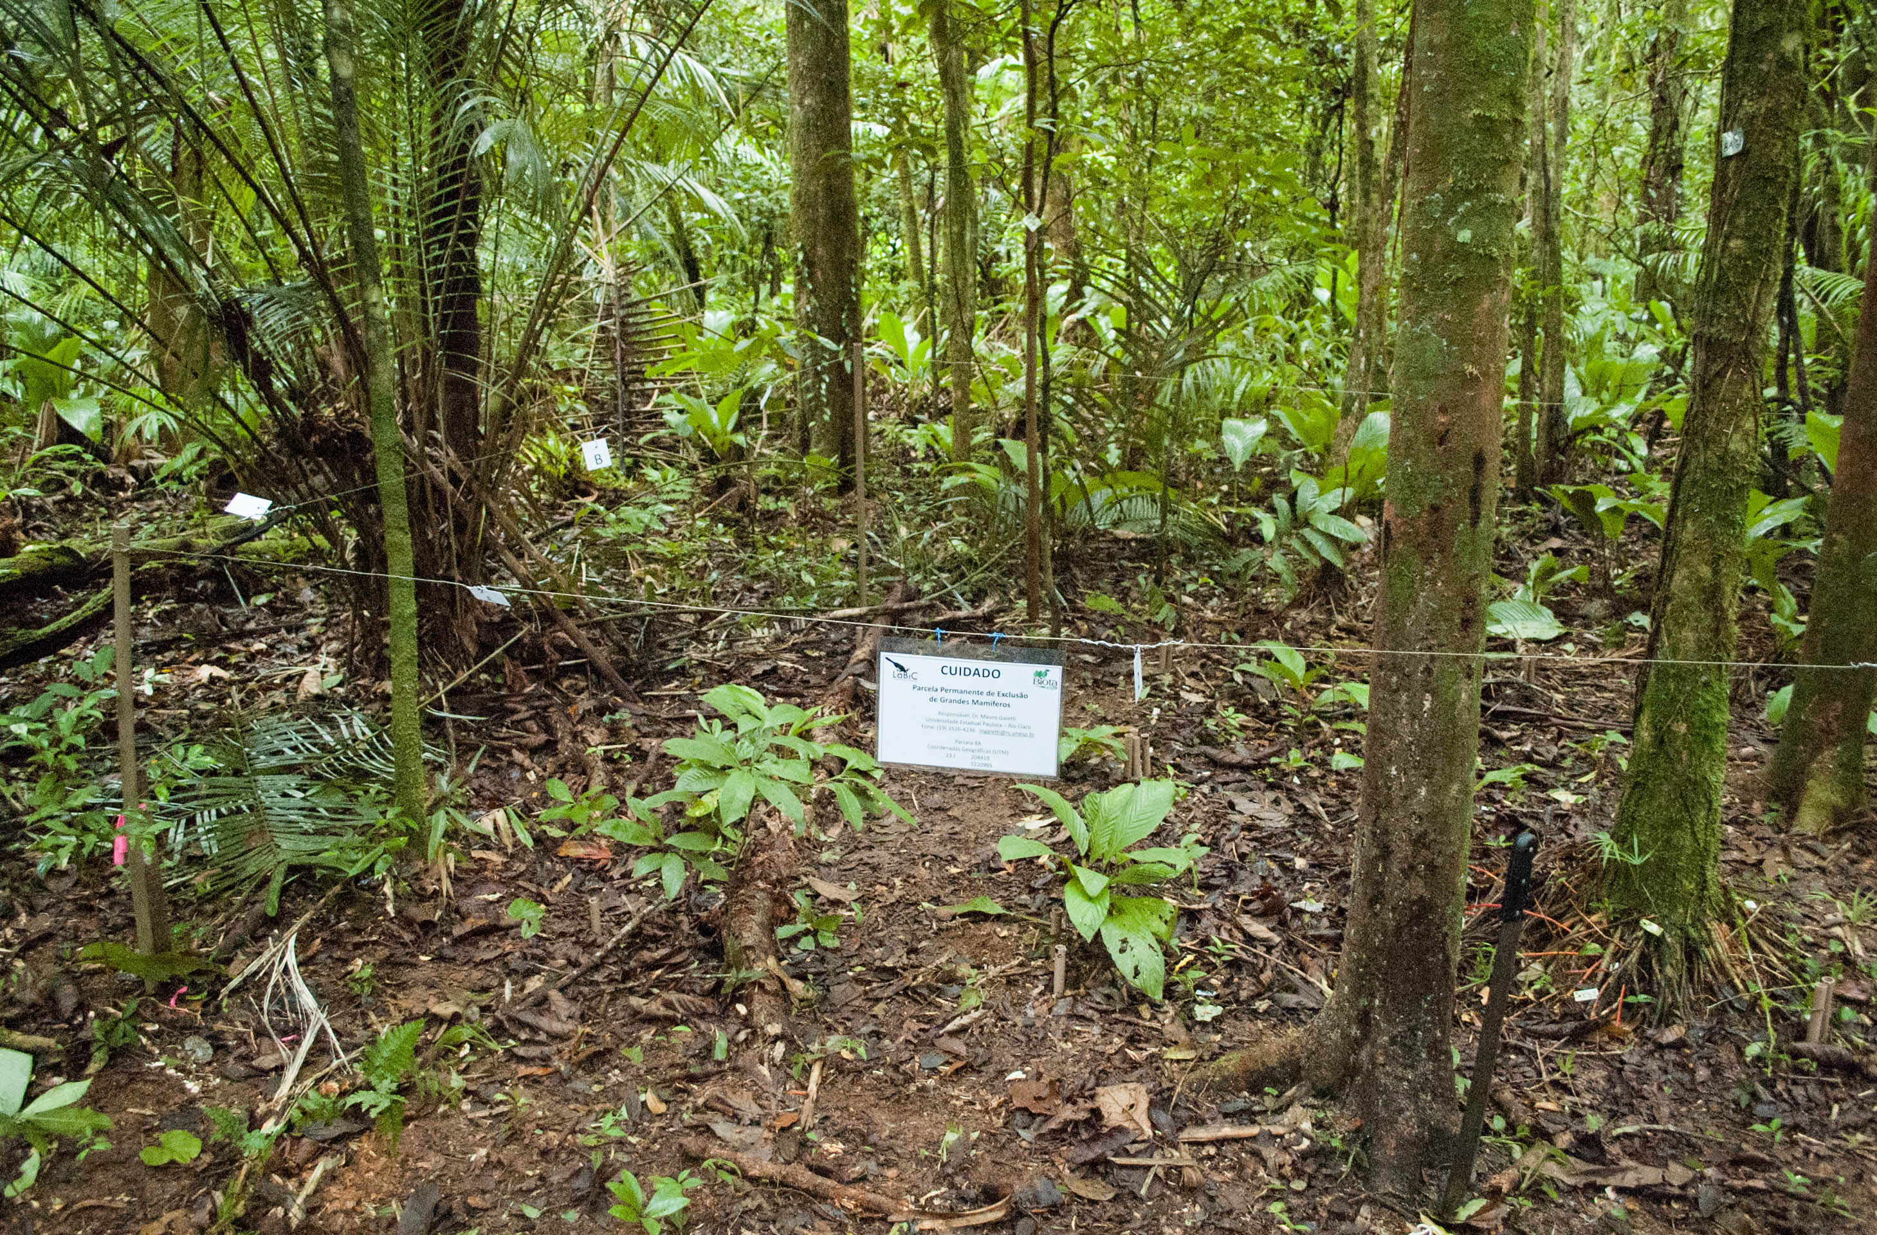
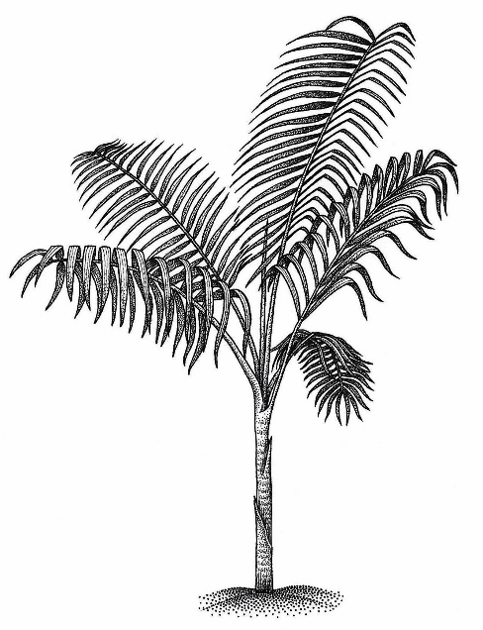
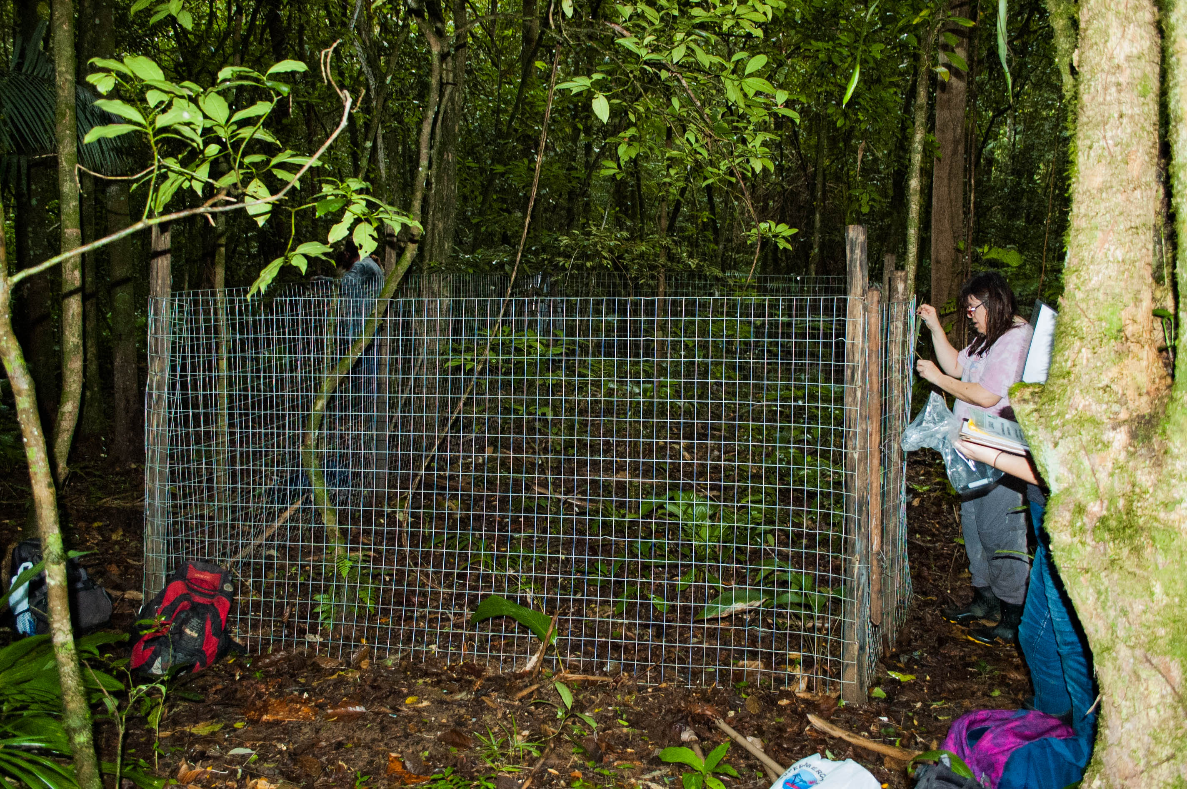
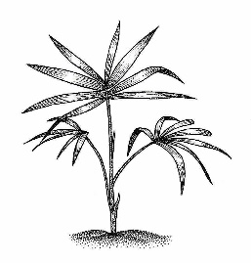
Exclusion Plots
1m
10cm

Slide 4
Exclusion Plots
1m
10cm
Response Variables
Abundance;
Inverse Simpson Diversity Index;
Predictor
Treatment ( Open vs Closed);
Model
Synchrony analysis: Quantify spatial and temporal patterns using Monte Carlo randomizations;

Slide 5
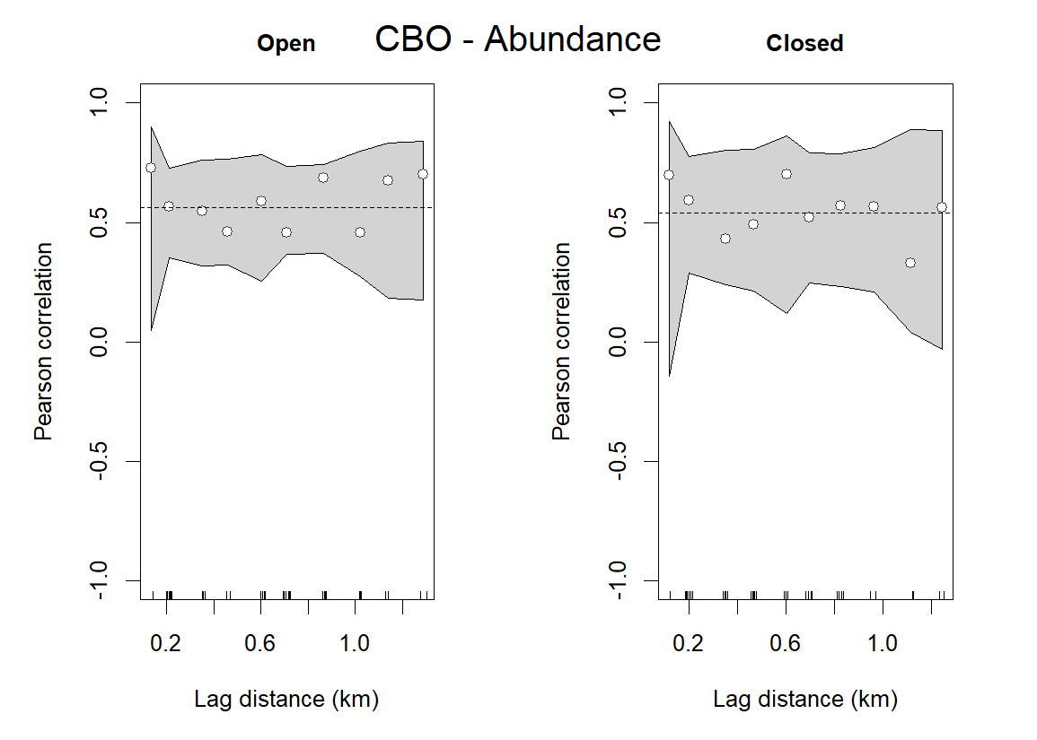
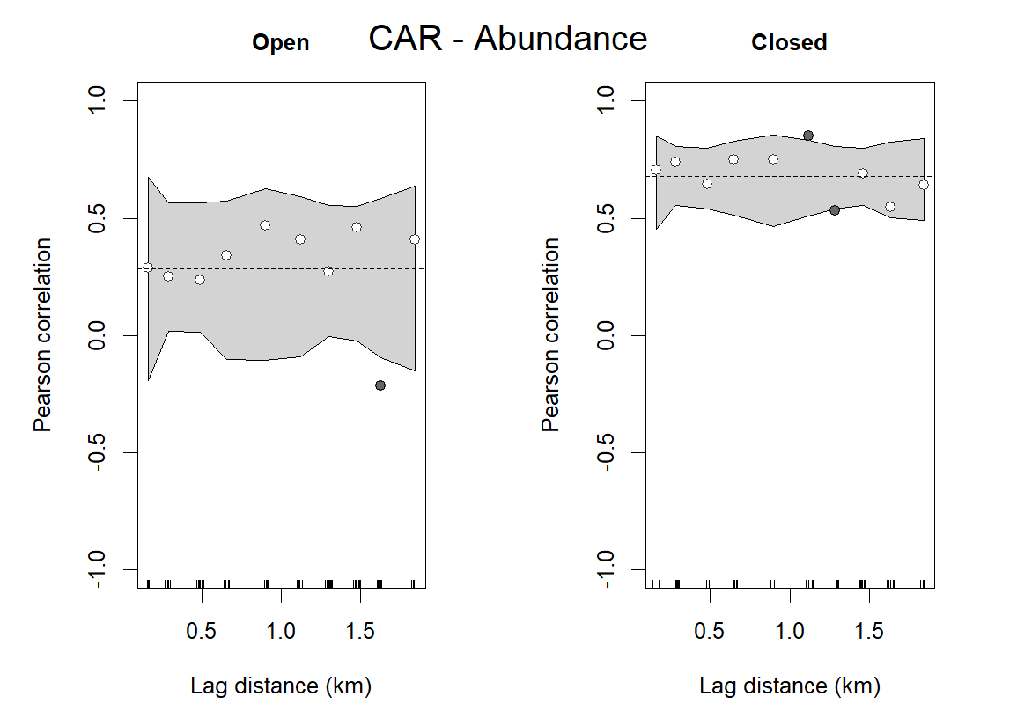
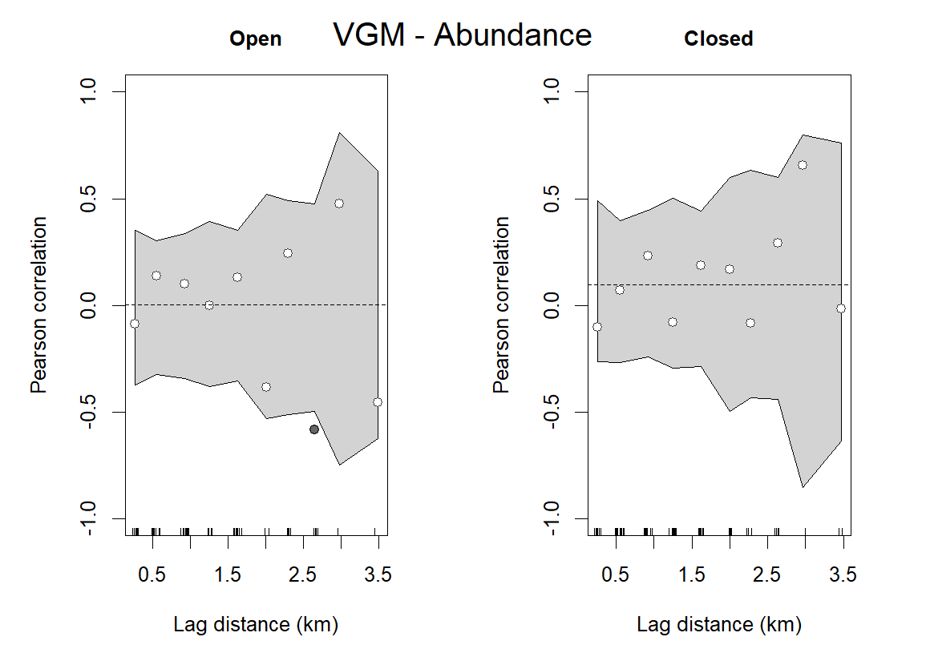
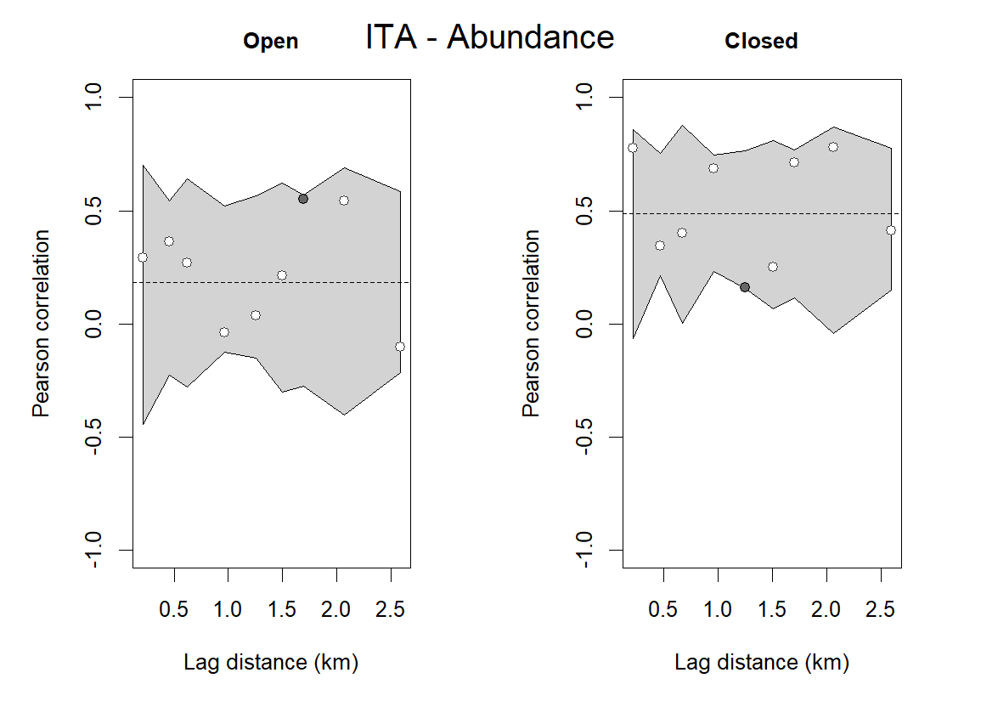
RMSE: 0.09967
AIC: -42.12
RMSE: 0.09883
AIC: -42.29
RMSE: 0.1867
AIC: -29.57
RMSE: 0.08373
AIC: -45.6
RMSE: 0.3082
AIC: -19.54
RMSE: 0.2034
AIC: -27.85
RMSE: 0.2205
AIC: -23.21
RMSE: 0.2243
AIC: -22.9

Slide 6
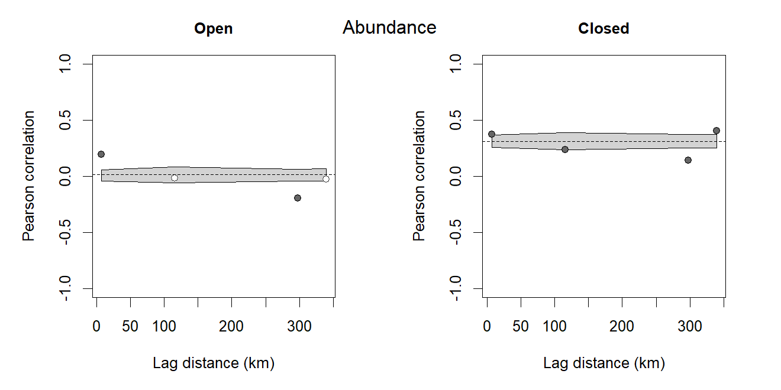


RMSE: 0.08401
AIC: -15.81
RMSE: 0.1057
AIC: -13.98

Slide 7
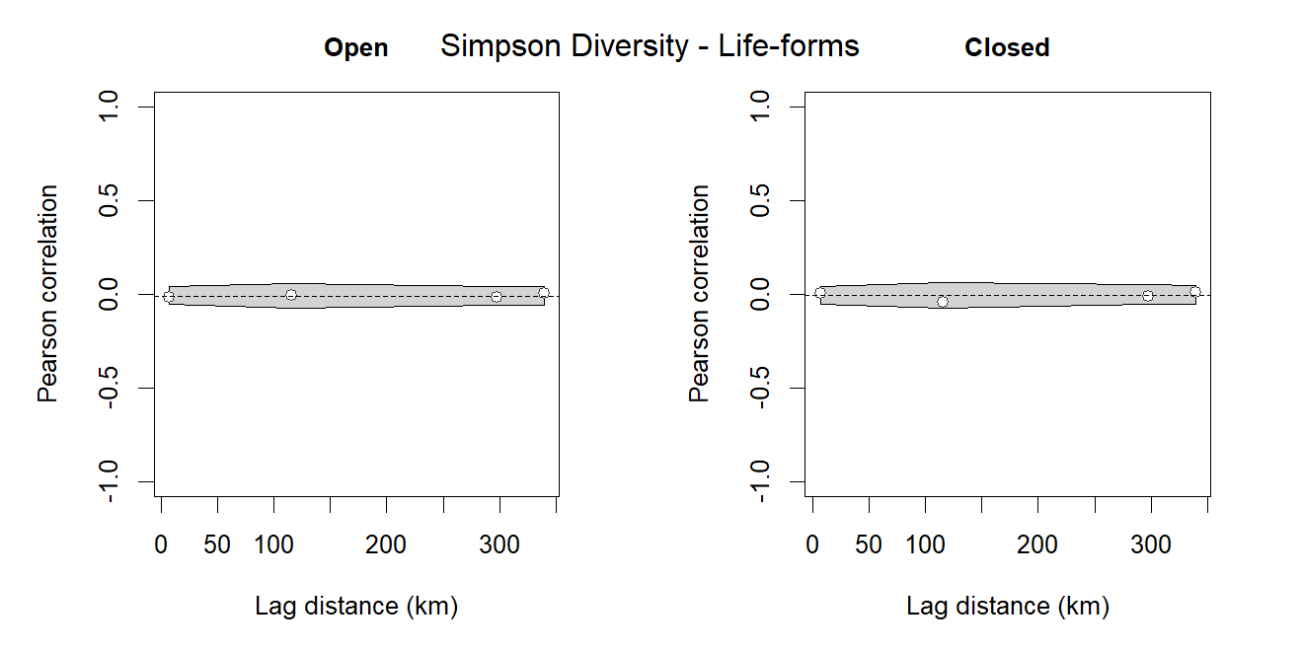





RMSE: 0.08401
AIC: -15.81
RMSE: 0.1057
AIC: -13.98
RMSE: 0.01168
AIC: -31.6
RMSE: 0.02259
AIC: -26.32

Slide 8
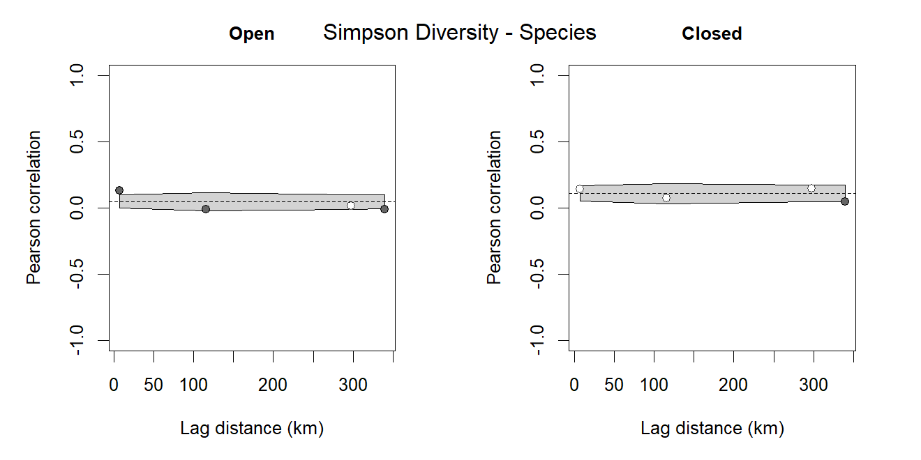
RMSE: 0.08401
AIC: -15.81
RMSE: 0.1057
AIC: -13.98
RMSE: 0.01168
AIC: -31.6
RMSE: 0.02259
AIC: -26.32
RMSE: 0.04183
AIC: -21.39
RMSE: 0.04059
AIC: -21.63

Slide 9

Medium and large herbivores are essential for shaping plant community dynamics while maintaining spatial heterogeneity
Open
Closed
Increase in heterogeneity by showing different abundance trajectories across space and time;
Don’t change functional diversity, but change species diversity;
Positive feedback effect related to abundance and species diversity.
Homogenization trend across time and space;
No changes in functional diversity;
Negative change in species diversity, where defaunated plots became more similar over time and across space.
Next step: Looking at ontogeny and life history dynamics (recruitment, mortality, competition, density dependence)

